Slide 1
DSCI 521
NLP Song Analysis for Lyrics
Project By:
Abhishek Shetty
Siddharth Dudugu
Michael Visco
Harsh Ramesh

Slide 2
Our Team
Abhishek Shetty (aas373@drexel.edu)
MS in Data Science
Skills: NLP, Feature Engineering, Networks, Predictive Modeling
Worked on: Data Acquisition & Pre-processing, Visual Analysis, Standardization & Tokenization, Lyrics Count.
Siddharth Dudugu (sd3627@drexel.edu)
MS in Data Science
Skills: Data Pre-processing, Predictive Analysis, ML Algorithms, Data Visualizations
Worked on: EDA, Word Frequency & Sentiment Analysis
Michael Visco (mjv64@drexel.edu)
MS in AI & ML
Skills: ML Algorithms, Numpy, Tensorflow
Worked on: Predictive Model Pre-processing, Predictive Models
Harsh Ramesh (hr439@drexel.edu)
MS in Data Science
Skills: Data Pre-processing, Predictive Analysis, Data Visualizations, NLP
Worked on: EDA, Word Frequency Analysis, Sentiment Analysis,

Slide 3
Project Overview
For our project, we wanted to analyze song lyrics for several things:
Word count trend: Visualize general trends for word count in relation to artists.
Lyric trend: Investigate which words are most commonly used by different artists.
Sentiment analysis: Investigate the overall sentiment related to each artist.
Predictive modeling: Predict the artist given the lyrics to a song

Slide 4
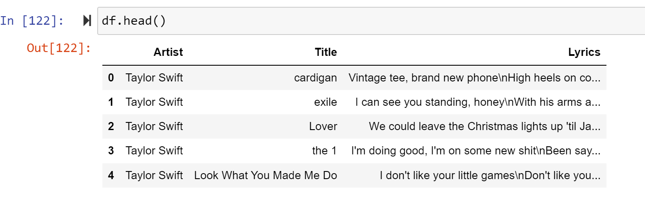
Identification and Description of the Data
Our dataset was acquired from Kaggle which consisted of three columns namely: Artists, Label & Lyrics.
Link to Datasets:
https://www.kaggle.com/datasets/karnikakapoor/lyrics
https://www.kaggle.com/datasets/deepshah16/song-lyrics-dataset?select=csv
Snapshot of Dataset

Slide 5
Stakeholders and Use
Artists: The artists could relate their song length, use of words and overall sentiment of the song and then analyse these areas. They could see the trend of lyrics, song sentiments and words in the current scenario and then make songs to fit the current scenario.
Music Streaming Platforms: The streaming platforms can use our system to observe the sentiment related to the songs and then generalize their category.
Movie Directors: The directors could observe the lyrics length to ensure it fits the general criteria and could also suggest changes in the words to make the sentiment of the song fit the overall sentiment of the scene.
Music Producers: The music producers could suggest change in repetitive words by an artist and they could also suggest changes in sentiment to fit the requirement.
Song Writers: The song writers could use our predictive model to know which artist could best deliver the lyrics that they have written.

Slide 6
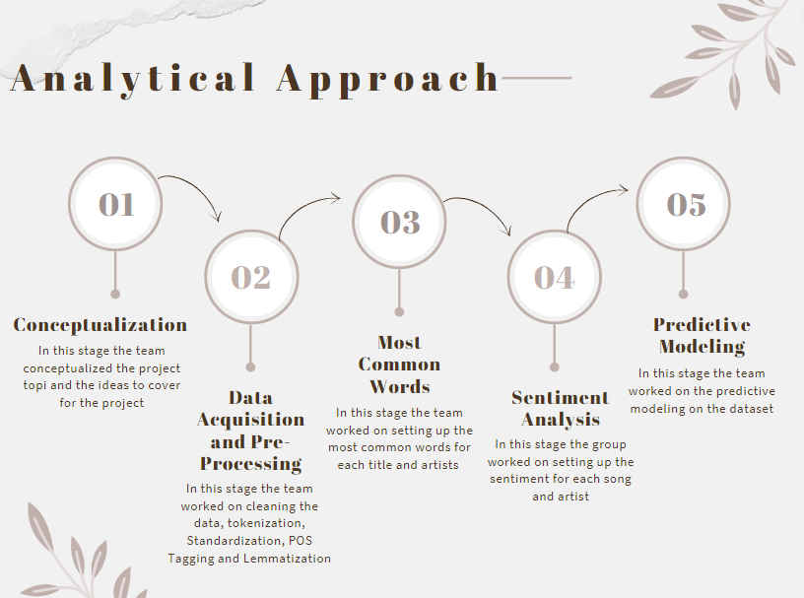

Slide 7
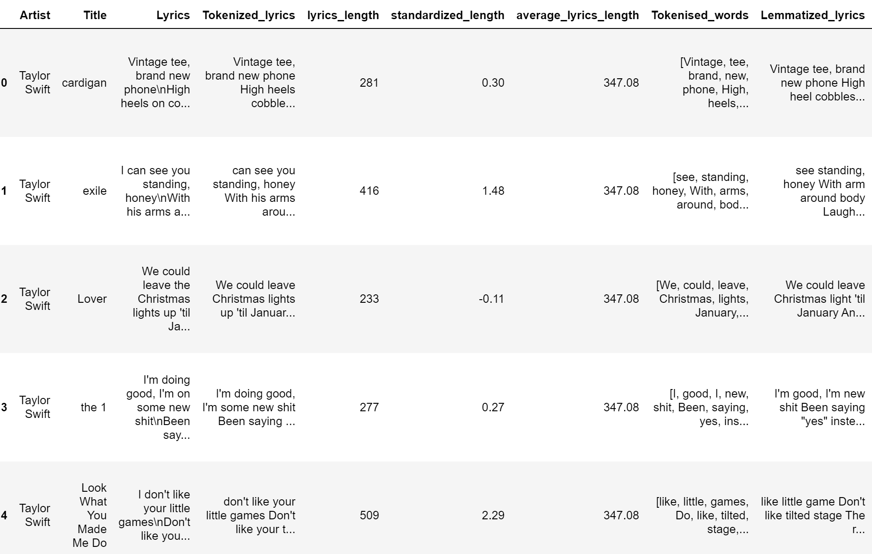
Data Pre-Processing
Tokenized Lyrics: In this section we tokenized all the words in the lyrics and removed all redundant words like “the, is, \n” etc.
Lyrics Length: We calculated the lyrics length for each of the lyrics
Standardized Length: We standardized the Length of each of the lyrics
Average Lyrics Length: We assigned the average lyrics length of all songs combined by each of the actors.
Tokenized Words: In tokenized words we tokenized the words in a list, removed stop words for further POS tagging.
Lemmatized Lyrics: In this section we lemmatized each of the words in the lyrics, removed apostrophes and special characters etc.

Slide 8
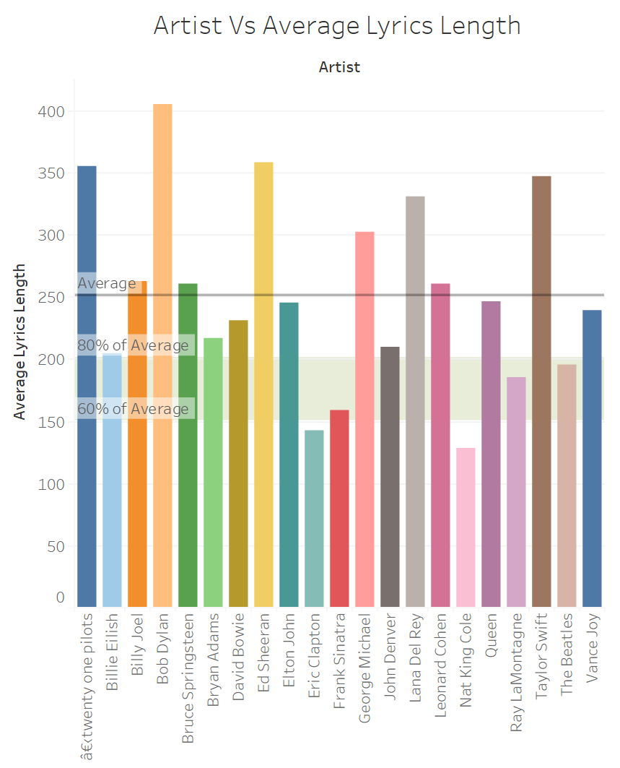
Artists Lyrics Length Plot
In this section we have plotted the average lyrics length for each of the artist.
We have also plotted an Average Trend line to show the average lyrics length and a 80% and 60% average block line.
Through this plot we can clearly see that Bob Dylan is the speechiest artist whereas Nat King Cole is the least speechiest artist among all. While Elton John can be considered as one which is closest to the average lyrics length.

Slide 9
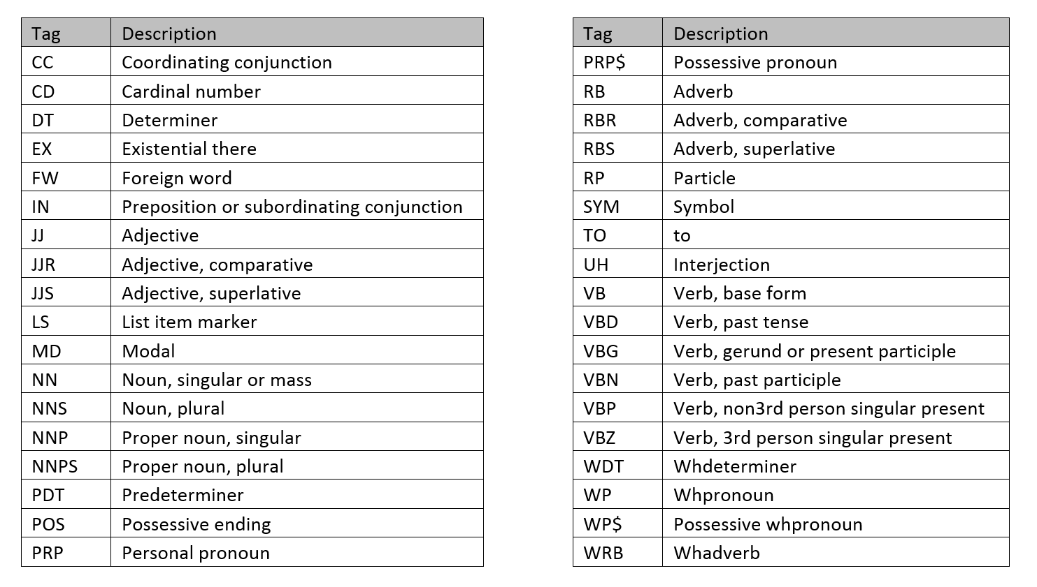
Parts of Speech(POS) Tagging
POS tagging is the process of labeling the words in a sentence with their corresponding part of speech, such as noun, verb, adjective, etc.
Below are a few predefined POS tags.

Slide 10
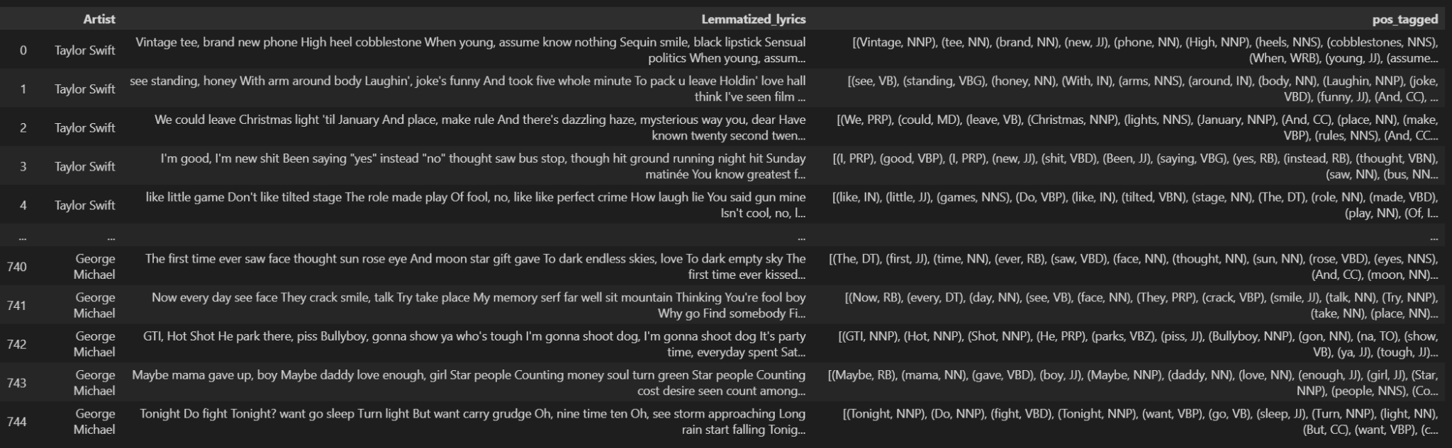
Parts Of Speech(POS) Tagging
POS tagging can help to identify the sentiment of a sentence by identifying the adjectives and verbs used in the sentence.
The stopwords and punctuations are excluded and the remaining tokenized words are tagged with their POS.

Slide 11
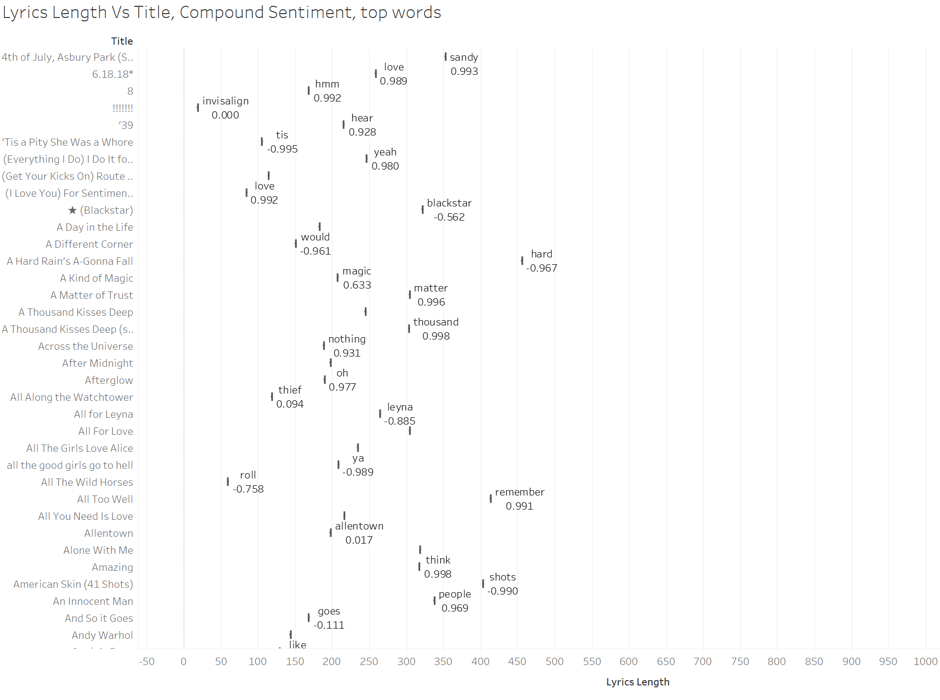

Slide 12
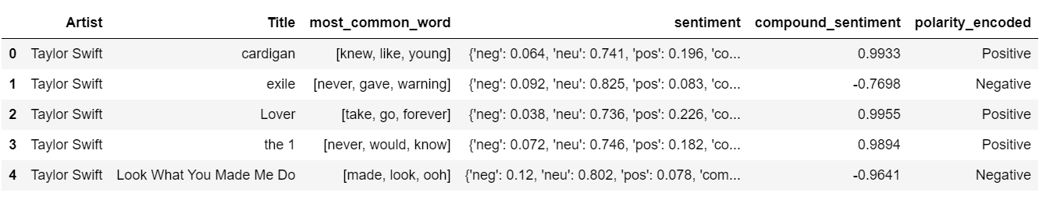
Sentiment Analysis
Sentiment analysis is the approach of natural language processing used to identify, extract and analyze subjective information from textual data.
Aim: Used to understand the emotional tone, attitude, and opinions expressed in a piece of text.
The steps involved in sentiment analysis are:
Preprocessing (cleaning, tokenization, and normalization)
Extract features (word frequencies, n-grams, and part-of-speech tags)
Polarity : Sentiment conveyed by a particular text, phrase or word. It is expressed as a numerical rating that lies between [-1,1]

Slide 13
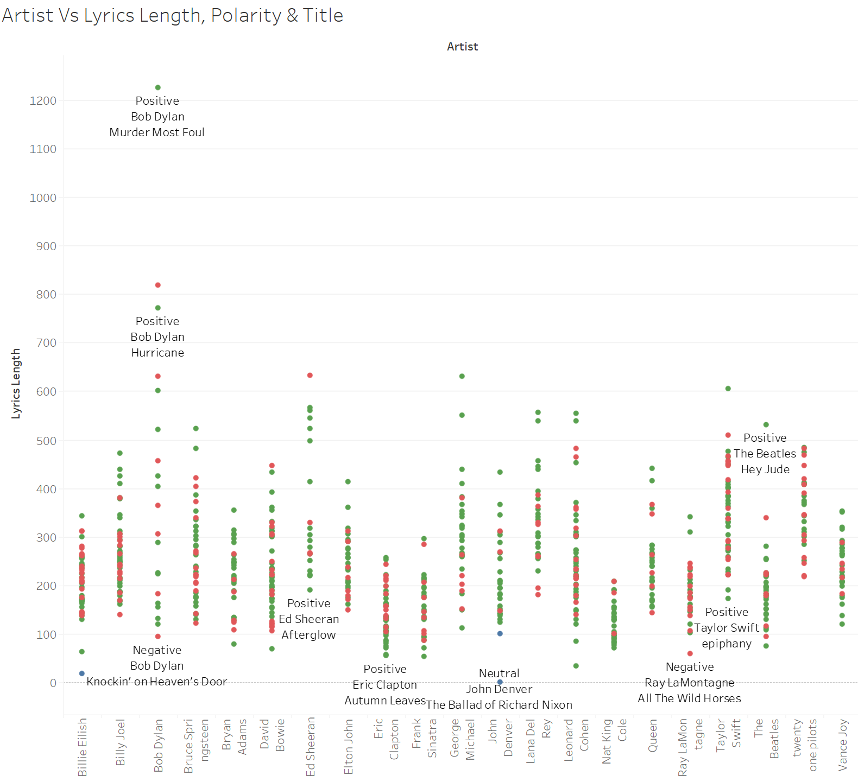
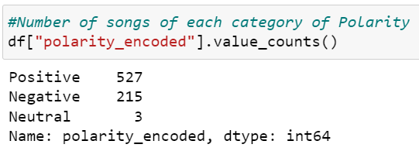
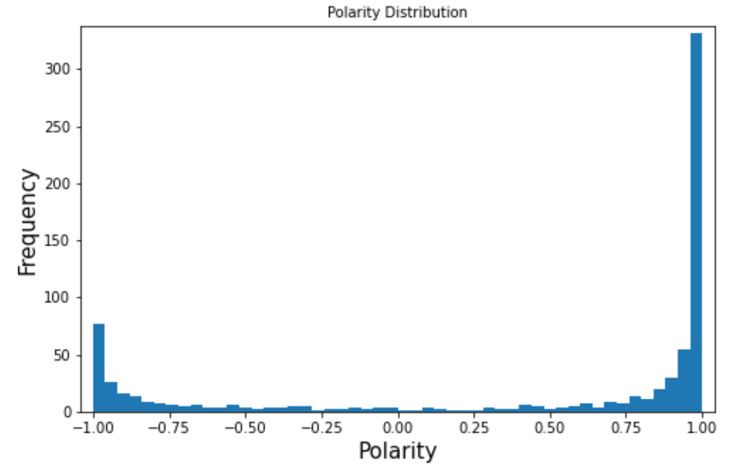

Slide 14
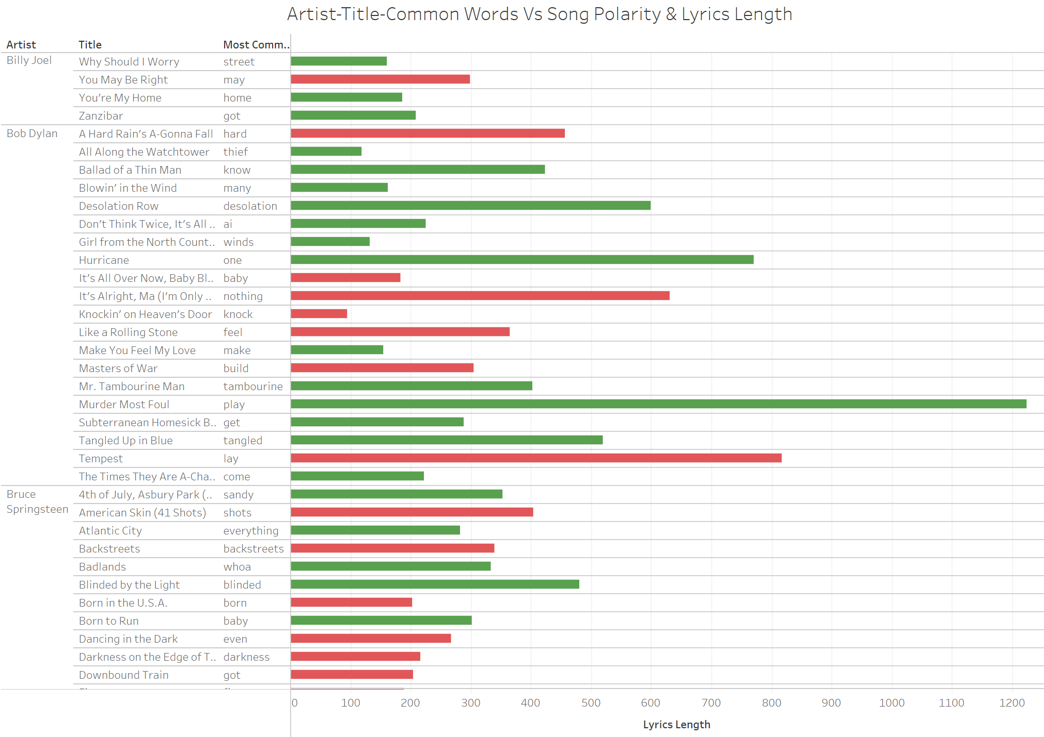

Slide 15
Predictive Models Overview
Dataset 1: 745 song total. 21 artists
Dataset 2: 296 song each of 12 artists
The Model: Bag Of Words!
Data Cleaning
Dense 100 out
ReLu activation
25% Drop
Dense 50 out
ReLu activation
25% Drop
Dense 21/12 out Softmax activation
This model was ran on both datasets for 200 epochs with a batch size of 70. One fourth of the data was used for validation.
Notes:
mike

Slide 16
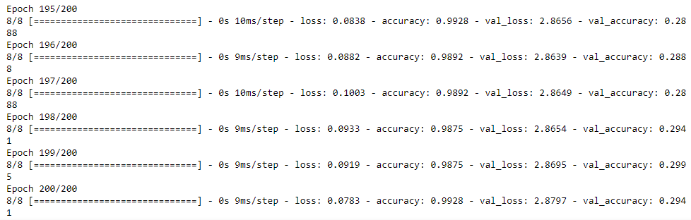
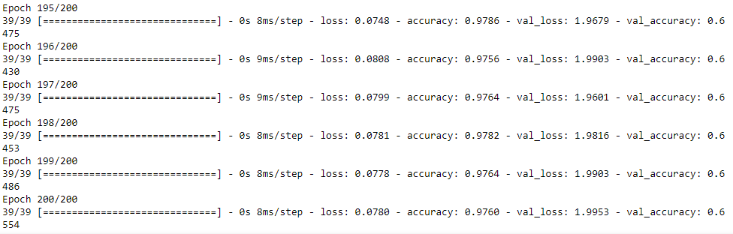
Predictive Models Results
Val-Acc
29%
Dataset 1
Val-Acc
66%
Dataset 2
Notes:
mike

Slide 17
Predictive Models Interpretation
Dataset 1 is 6.09x better than random while dataset 2 is 7.92x better than random
There are multiple reasons these results can be seen
More data provides us with a more accurate prediction
With dataset 2 having less artists, there may be less genre overlap
The artists included in the second dataset could use more unique lyrics
Notes:
mike

Slide 18
Challenges, Issues and Limitations
Challenges:
Procuring dataset that is large enough for predictive modeling
Ambiguity of words used in the lyrics for POS Tagging.
“word###EmbedShare” found in the lyrics
Issues:
Some jargons could not be detected during lemmatization
Words used in different languages
Limitations:
Limited Data
Limited Attributes to work on
Notes:
mike

Slide 19
Future Work
Add more artists and songs to the dataset to train the model to be more accurate and span more artists for the practical applications
Enhance the data to give more categories (i.e. song billboard rank, release date, album name, genre, ect.) and create models that use those new categories to better predict the artist.
Utilize these new categories to predict billboard rank based on all other factors so writers and artists could try to predict if their song is a hit.
Notes:
mike

